Slide 1
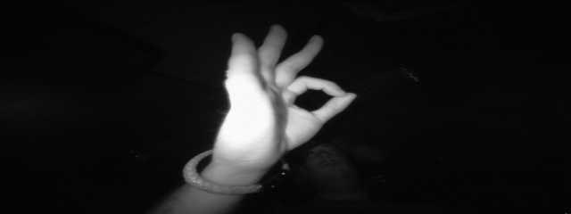

Gesture Recognition using Nengo
By Jonas Pirkl und Moritz Backhaus
(3248270) und (3689776)

Slide 2
Agenda
Original Paper
Our Networks
Network Comparison
Live-Demo
Project Evaluation

Slide 3
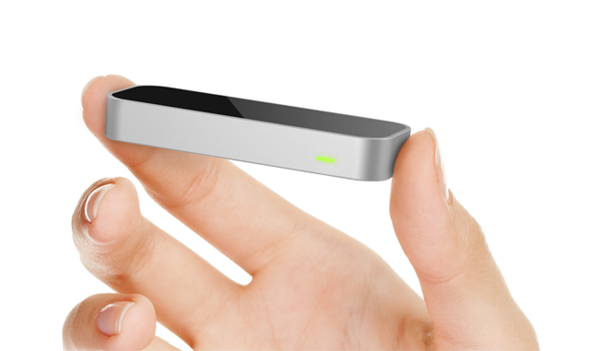
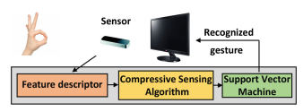
Hand Gesture Recognition Using Infrared Imagery Provided by Leap Motion Controller
Used sensor (Leap Motion Controller) is closed ranged
=> No distracting environmental details, mostly hand
Optimized for motion tracking
Cameras have wide field of view
Most research focuses on skeleton trajectory
Gesture recognition often done using multiple sources
Paper only uses the infrared image of one of the cameras
Mantecón, T., del-Blanco, C.R., Jaureguizar, F., García, N. (2016).
Hand Gesture Recognition Using Infrared Imagery Provided by Leap Motion Controller.
In: Blanc-Talon, J., Distante, C., Philips, W., Popescu, D., Scheunders, P. (eds) Advanced Concepts for Intelligent Vision Systems.
ACIVS 2016. Lecture Notes in Computer Science(), vol 10016. Springer, Cham.

Slide 4
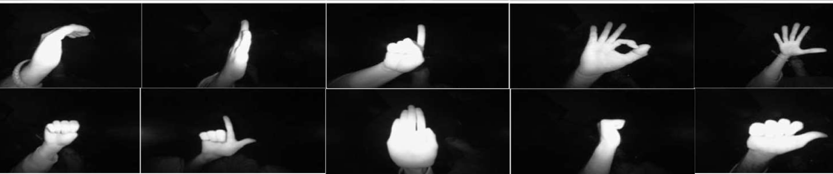
Hand Gesture Recognition – Data Set
c
palm moved
index
ok
down
fist
l
palm
fist moved
thumb

Slide 5
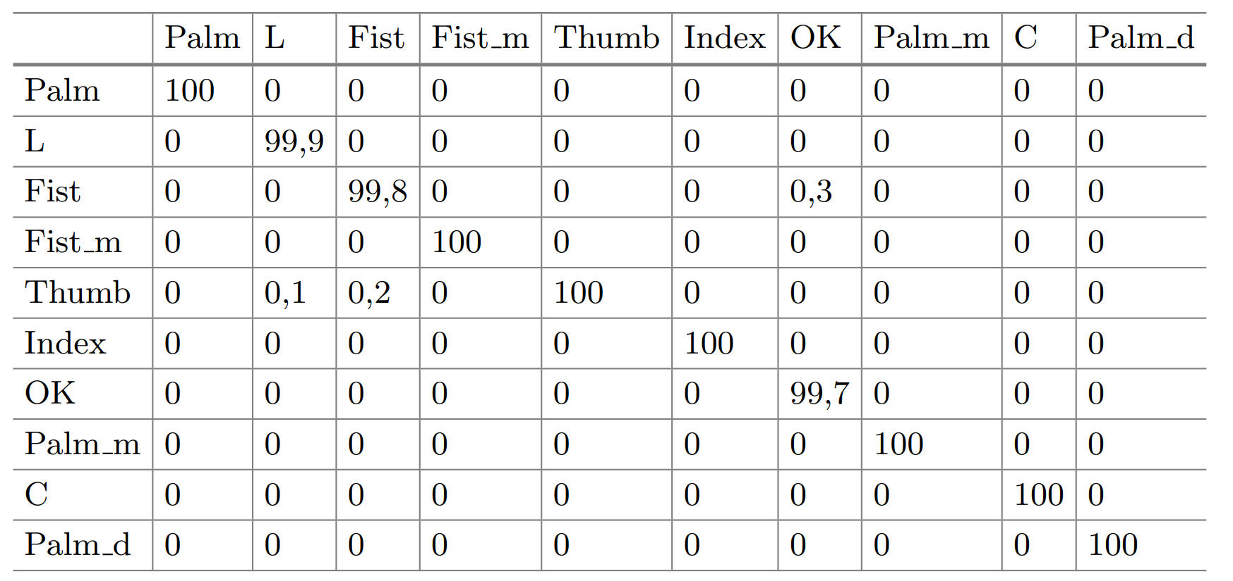
Hand Gesture Recognition Using Infrared Imagery Provided by Leap Motion Controller
Classification using SVM
50/50 Train/Test split
Dataset
640x240 size images with 60fps
10 gestures by 10 person (5m & 5f)

Slide 6
Our Nets
Big CNN
M
M
M
F
M
32 5x5
64 3x3
96 3x3
96 3x3
512
10
Medium CNN
F
60x160
M
M
10
32 5x5
64 3x3
Small CNN
28x28
F
M
M
10
32 5x5
64 3x3

Slide 7
Our Nets
Nengo NN
51200 (160x320)
Nengo CNN
F
60x160
M
M
10
32 5x5
64 3x3
Nengo CNN
28x28
F
M
M
10
32 5x5
64 3x3

Slide 8
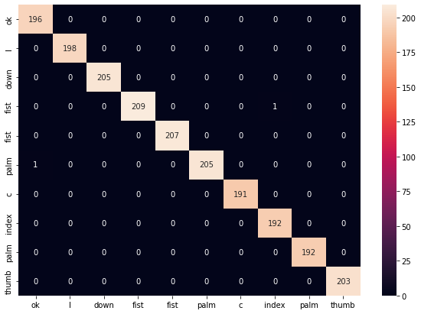
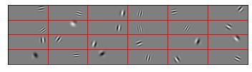
Nengo NN
Ensemble Size: 1000
Solver: LstsqL2
Encoder: Sparse Gabor filter (64x64 filter size)
Similar representations to those of the human visual system
Training duration: 30.8s
Test accuracy: 99.9%
F2-Score: 0.99

Slide 9
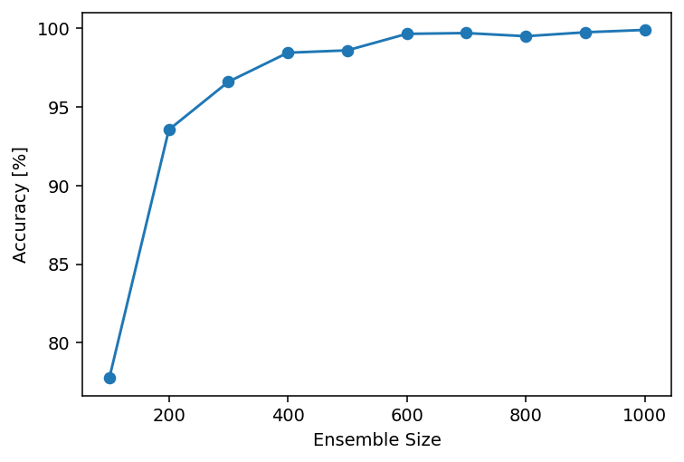
Nengo NN
Size | 100 | 200 | 300 | 400 | 500 | 600 | 700 | 800 | 900 | 1000
Accuracy | 77,75% | 93,55% | 96,60% | 98,45% | 98,60% | 99,65% | 99,70% | 99,35% | 99,65% | 99,9%

Slide 10
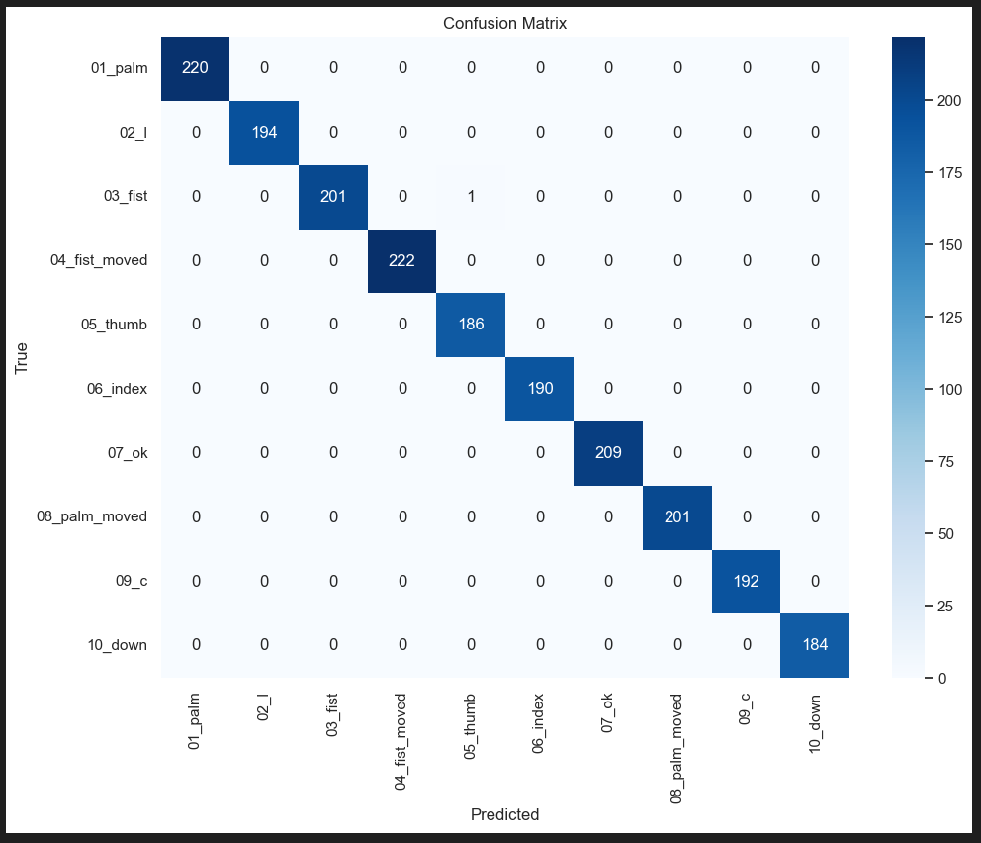
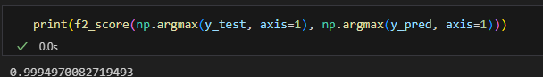
CNNs for Gesture Recognition
Model | Big CNN | Medium CNN | Small CNN
Train Acc. | 0.99
Val. Acc. | 0.99
Test Acc. | 0.99
F2-Test | 0.99

Slide 11
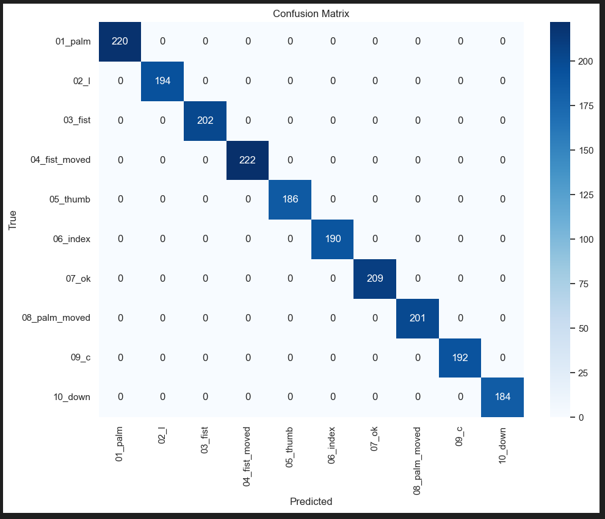
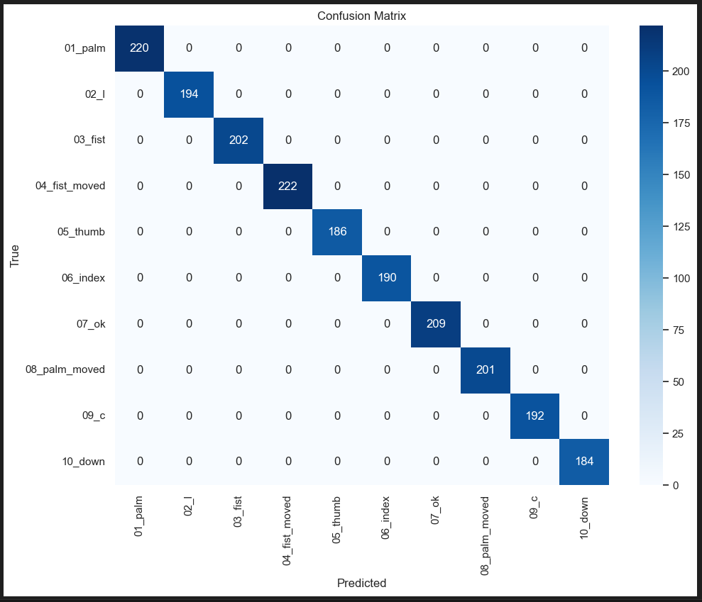
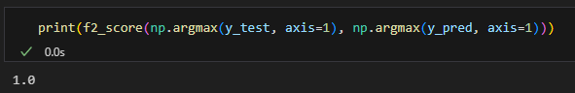
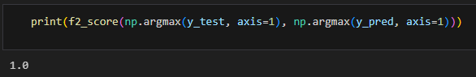
CNNs for Gesture Recognition
Model | Augmentation CNN | Dropout CNN | CNN
Train Acc. |  | 0.99
Val. Acc. |  | 0.99
Test Acc. |  | 0.99
F2-Test |  | 0.99
Model | Big CNN | Medium CNN | Small CNN
Train Acc. | 0.99 | 1
Val. Acc. | 0.99 | 1
Test Acc. | 0.99 | 1
F2-Test | 0.99 | 1

Slide 12
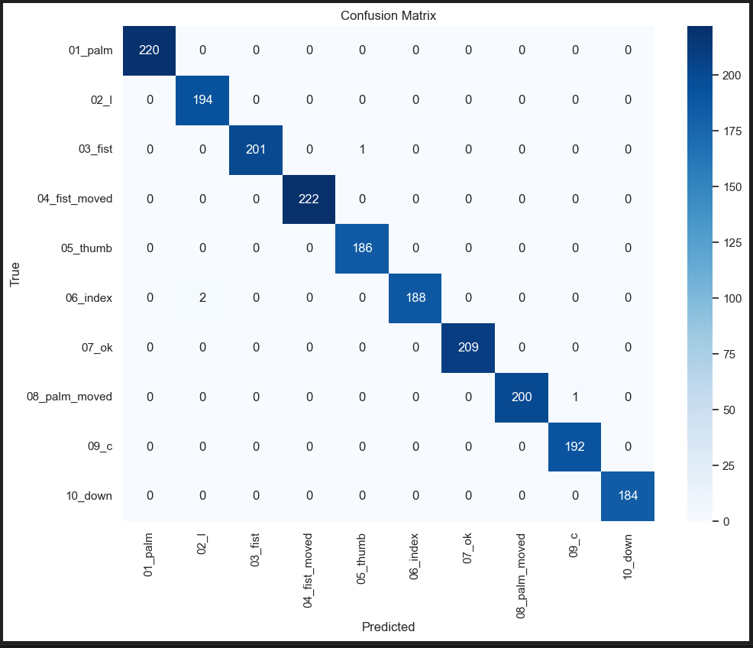
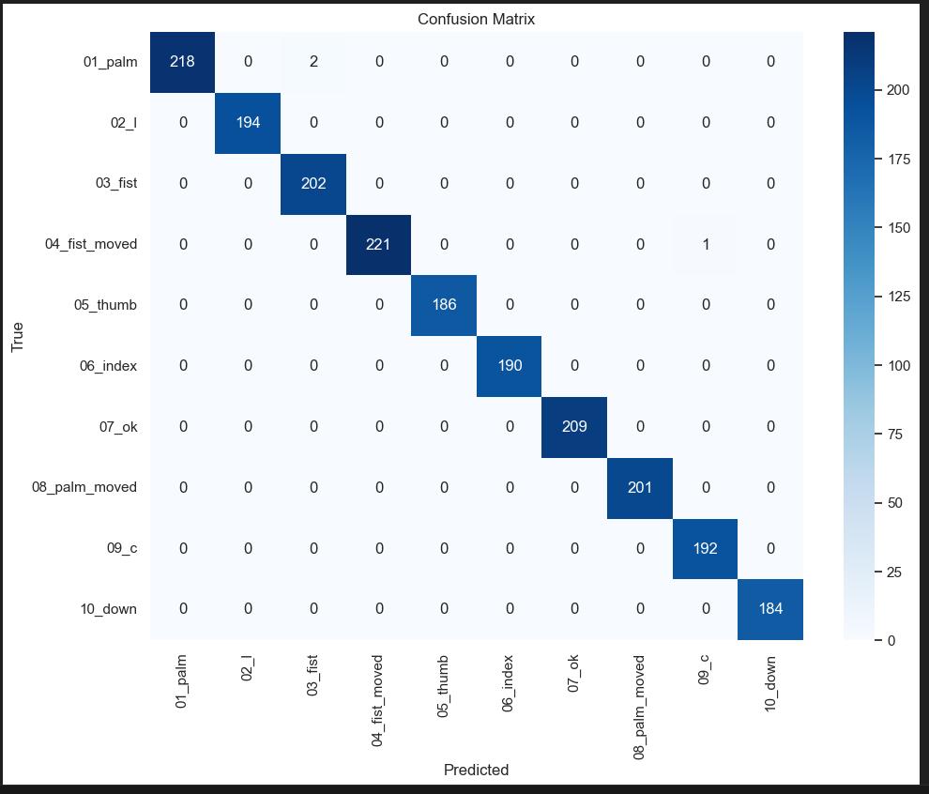
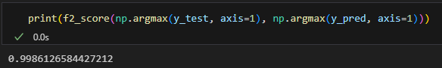
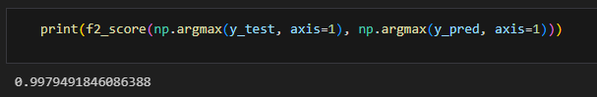
CNNs for Gesture Recognition
Model | Augmentation CNN | Dropout CNN | CNN
Train Acc. |  | 0.99
Val. Acc. |  | 0.99
Test Acc. |  | 0.99
F2-Test |  | 0.99
Model | Big CNN | Medium CNN | Small CNN
Train Acc. | 0.99 | 1 | 0.99
Val. Acc. | 0.99 | 1 | 0.99
Test Acc. | 0.99 | 1 | 0.99
F2-Test | 0.99 | 1 | 0.99

Slide 13
CNNs for Gesture Recognition
Model | Big CNN | Medium CNN | Small CNN
Train Acc. | 0.99 | 1 | 0.99
Val. Acc. | 0.99 | 1 | 0.99
Test Acc. | 0.99 | 1 | 0.99
F2-Test | 0.99 | 1 | 0.99

Slide 14
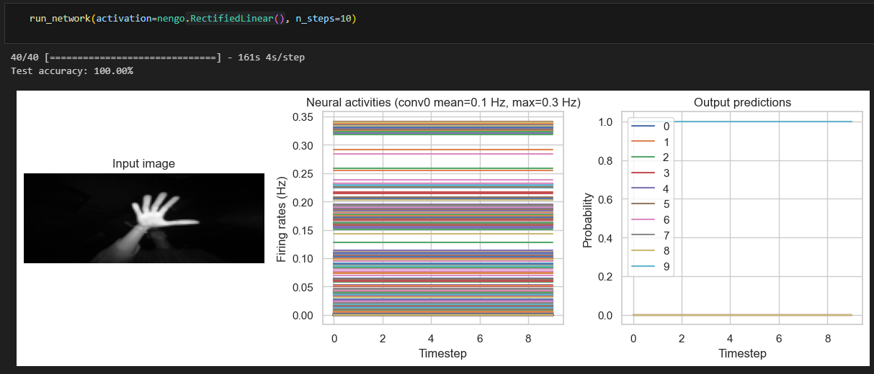
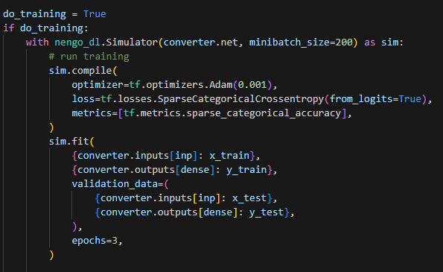
CNN for Nengo
no spiking activation
constant output

Slide 15
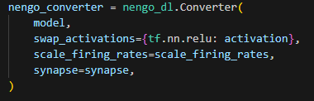
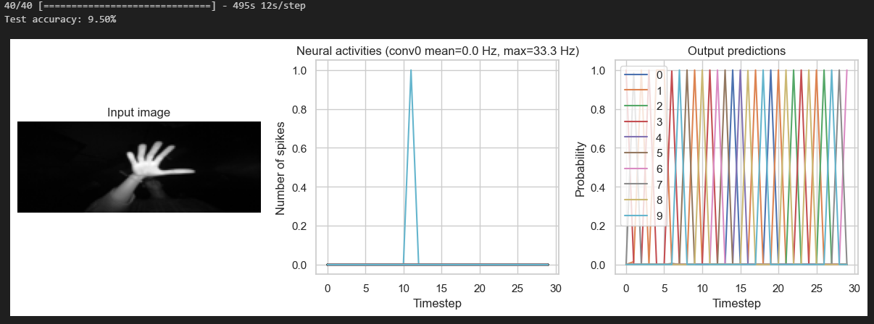
Tuning a Spiking Network
Activation: nengo.RectifiedLinear()
Firing Rates: 1
Synaptic Smoothing: None
Accuracy: 9.5%

Slide 16
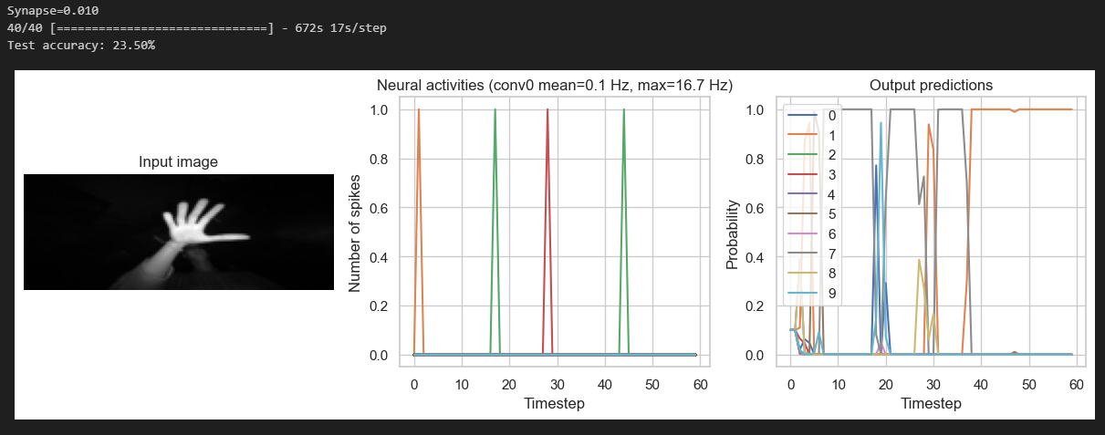
Tuning a Spiking Network
Activation: nengo.RectifiedLinear()
Firing Rates: 1
Synaptic Smoothing: 0.010
Accuracy: 23.5%

Slide 17
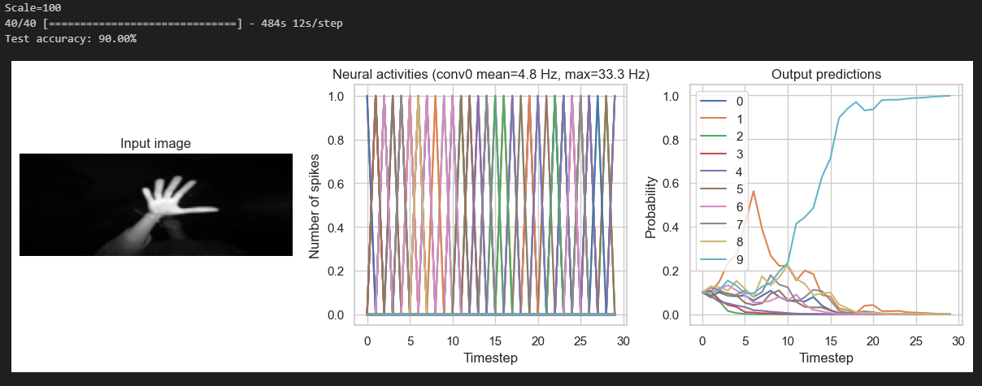
Tuning a Spiking Network
Activation: nengo.RectifiedLinear()
Firing Rates: 100
Synaptic Smoothing: 0.010
Accuracy: 90%
Scaling Input
Dividing output
Can simulate non-spiking

Slide 18
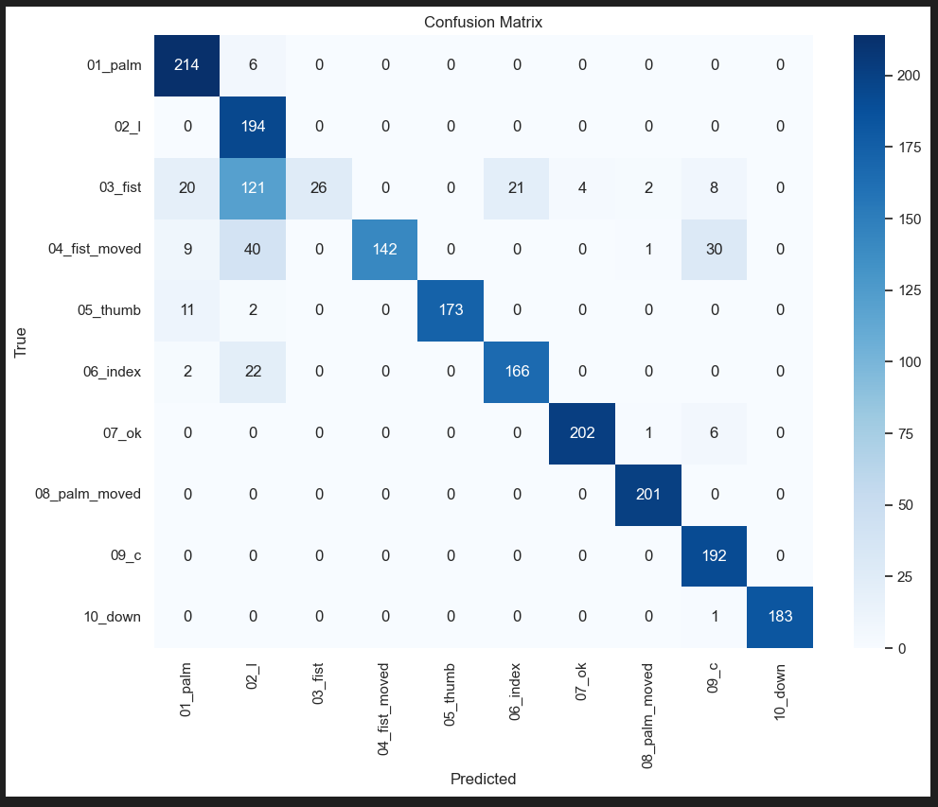
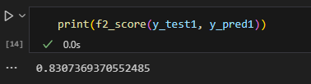
Spiking CNN
Model | 160x60 | 28x28
Train Acc. | 0.99
Val. Acc. | 0.99
Tuned Test Acc. | 0.90
F2-Test | 0.83

Slide 19
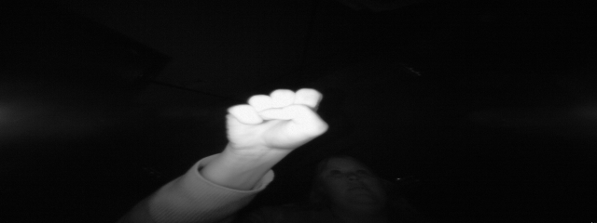
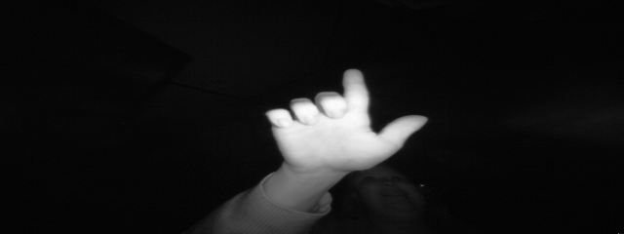

Slide 20

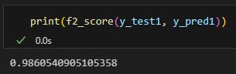
Spiking CNN
Model | 160x60 | 28x28
Train Acc. | 0.99 | 0.99
Val. Acc. | 0.99 | 0.99
Tuned Test Acc. | 0.90 | 0.99
F2-Test | 0.83 | 0.98

Slide 21
Comparison
Model | Nengo | 160x60 | 28x28 | Big CNN | Medium CNN | Small CNN | Original Paper (SVM)
Train Acc. | 0.99 | 0.99 | 0.99 | 0.99 | 1 | 0.99 | x
Val. Acc. | - | 0.99 | 0.99 | 0.99 | 1 | 0.99 | x
(Tuned) Test Acc. | 0.99 | 0.90 | 0.99 | 0.99 | 1 | 0.99 | 0.99
F2-Test | 0.99 | 0.83 | 0.98 | 0.99 | 1 | 0.99 | 0.99
Inference | 10 ms | 1s | 101ms | 24ms | 15ms | 15ms | x

Slide 22
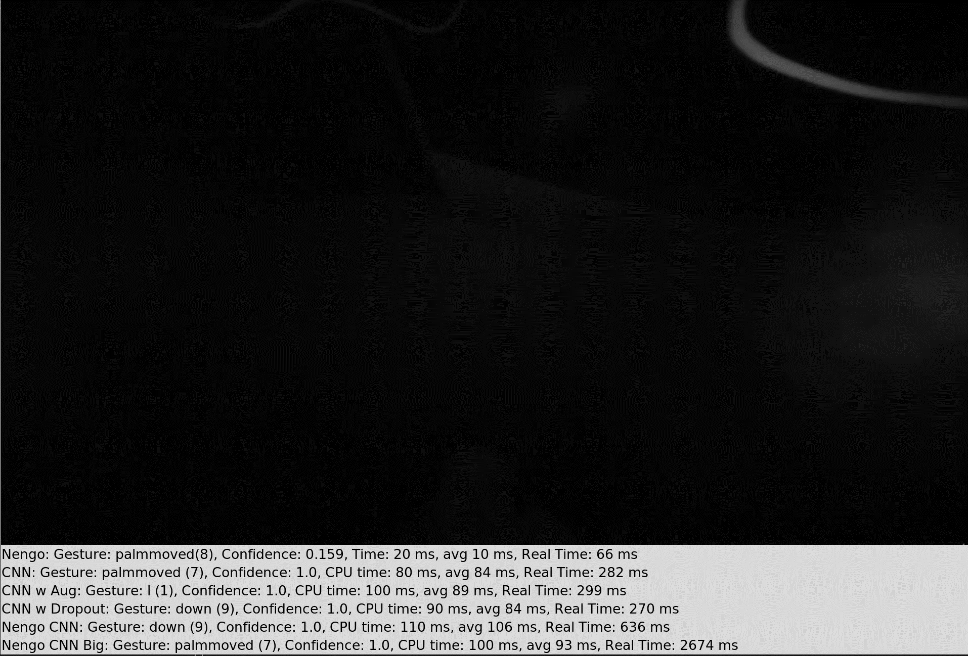
Demo

Slide 23
Assesment
Data Set
Neural Networks
Application

Slide 24
Assesment
Data Set
Strenght of Leap Motion Sensor noticable
Data Set is missing a default class

Slide 25
Assesment
Neural Networks
Overfitting is a problem
Intresting tuning of spiking neurons
Efficiency of spiking neurons not experienced

Slide 26
Assesment
Application
Real life application not possible
More diverse dataset needed
Promissing results
Small spiking networks with high acc.
Potential new HCI use cases

Slide 27
Ihr bestes Angebot, das ihren Ansatz widerspiegelt... „Ein kleiner Schritt für den Menschen, aber ein riesiger Sprung für die Menschheit.”
– Neil Armstrong

